Slide 1



NodeJS Web Server
Serving HTTP requests
Telerik School Academy
Learning & Development
http://academy.telerik.com

Slide 2

Table of Contents
HTTP Fundamentals
What is Web Server
Create basic server with NodeJS
The Request stream object
The Response stream object
Route requests
Using NodeJS as client

Slide 3

HTTP Fundamentals

Slide 4
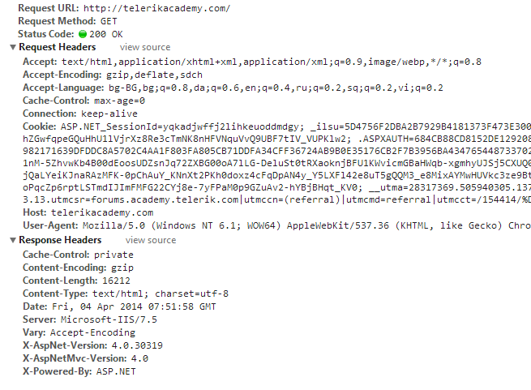
HTTP Fundamentals
Communication protocol – Request/Response

Slide 5
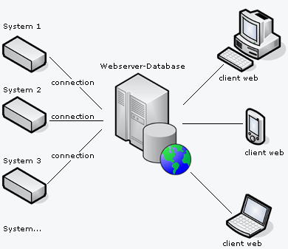
Web Server

Slide 6
Web Server
HTTP Web server
Remote hardware (high performance)
Processes clients' requests
Delivers web content to clients
Usually hosts many web sites
Apache and IIS (most common)
PHP, ASP.NET, Ruby, Python, NodeJS

Slide 7
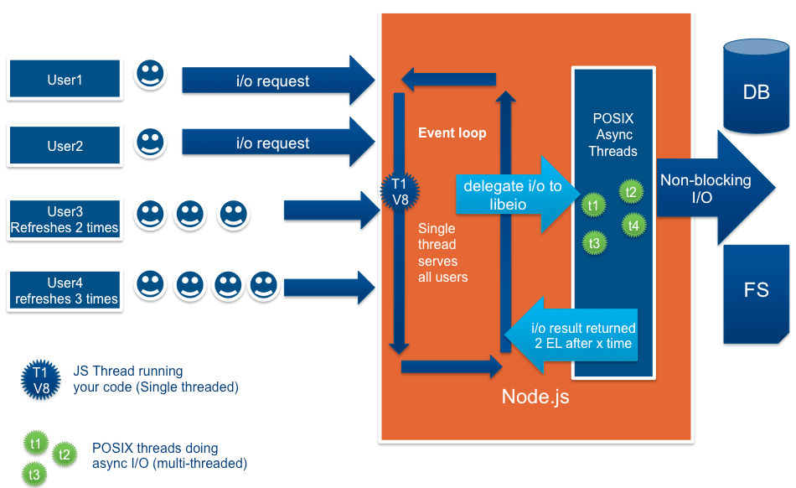
NodeJS Web Server

Slide 8
NodeJS Web Server
Require the 'http' module
Create server function (createServer)
Request/Response wrapper objects
Listen function (specifies port and IP (host))
Headers are objects (keys are lowercased)
{ 'content-length': '123',
'content-type': 'text/plain',
'connection': 'keep-alive',
'accept': '*/*' }

Slide 9
NodeJS Web Server
Basic server implementation
var http = require('http');
http.createServer(function(req, res) {
res.writeHead(200, {
'Content-Type': 'text/plain'
}); //return success header
res.write('My server is running! ^_^'); //response
res.end(); //finish processing current request
}).listen(1234);

Slide 10
NodeJS Basic Web Server
Live Demo

Slide 11

The Request Wrapper

Slide 12
The Request Wrapper
The Request wrapper
http.IncommingMessage class
Implements the Readable Stream interface
Properties
httpVersion – '1.1' or '1.0'
headers – object for request headers
method – 'GET', 'POST', etc
url – the URL of the request

Slide 13
The Request Wrapper
Live Demo

Slide 14

The Response Wrapper

Slide 15
The Response Wrapper
The Response wrapper
Implements the Writable Stream interface
Methods
writeHead(statusCode, [headers])
var body = 'hello world';
response.writeHead(200, {
'Content-Length': body.length, // not always valid
'Content-Type': 'text/plain',
'Set-Cookie': ['type=ninja', 'language=javascript']
});

Slide 16
The Response Wrapper
Methods
write(chunk, [encoding])
end()
Always call the methods in the following way
writeHead
write
end
response.writeHead('Hello world!'); // default encoding: utf8

Slide 17
The Response Wrapper
Live Demo

Slide 18

Route Requests

Slide 19
Route Requests
URL Parsing modules
'url' and 'querystring'
both have parse method
var url = require('url');
console.log(url. parse('/status?name=ryan', true));
// logs
// {
// href: '/status?name=ryan',
// search: '?name=ryan',
// query: { name: 'ryan' },
// pathname: '/status'
// }

Slide 20
Route Requests
Live Demo

Slide 21
NodeJS as Client

Slide 22
NodeJS As Client
http.request and http.get
both have (options, callback) signature
var req = http.request(options, function(res) {
console.log('STATUS: ' + res.statusCode);
console.log('HEADERS: ' + JSON.stringify(res.headers));
res.setEncoding('utf8');
res.on('data', function (chunk) {
console.log('BODY: ' + chunk);
});
});
http.get("http://www.google.com/index.html", function(res) {
console.log("Got response: " + res.statusCode);
})

Slide 23
Resources
http://nodejs.org/ - NodeJS official web site
http://nodejs.org/api/ - API documentation
http://blog.nodejitsu.com/npm-cheatsheet - NPM documentation
https://npmjs.org/ - NPM official web site
https://github.com/felixge/node-style-guide - NodeJS style guide

Slide 24
NodeJS Web Server
http://academy.telerik.com

Slide 25
Exercises
Create file upload web site with NodeJS. You should have the option to upload a file and be given an unique URL for its download. Use GUID and no ExpressJS.

